Slide 1
Training provider
- approval process

Slide 2


Licences available
CCNSG
Supervision & personal skills
Project control, estimating, risk etc.
Technical training standards
Technical testing
Technical short courses (site operations)
Notes:
Health and safety moment
Inclusion moment
Only keep course assessment in if this is relevant.

Slide 3
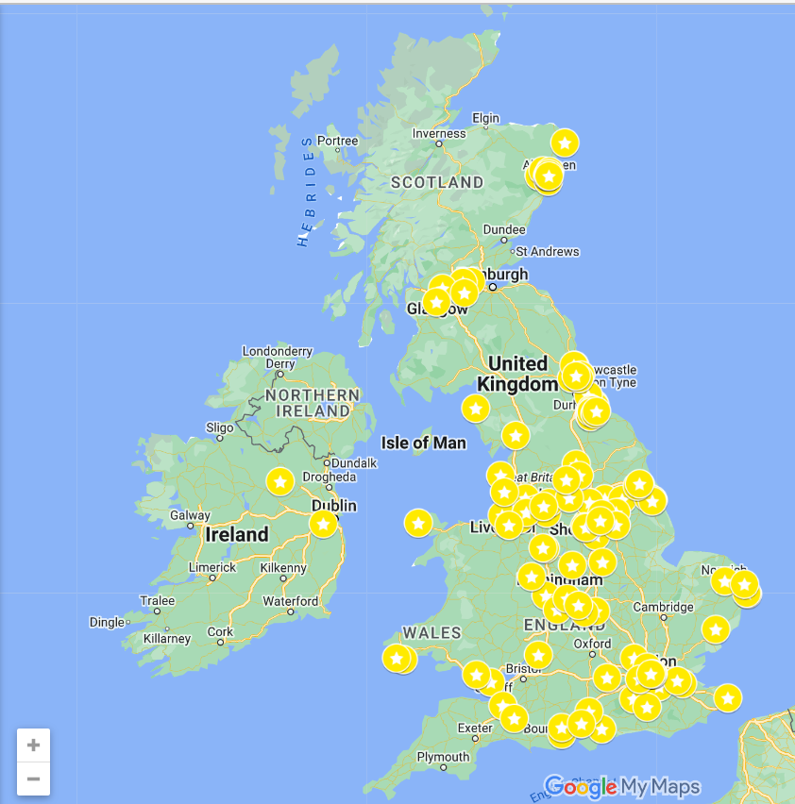
ECITB approved training provider locations

Slide 4
Approval process
Initial chat (this one)
Business case
Financial and legal checks
Policies & procedure checks
Trainer, premises, practical rig checks
Licence issued & signed
Supportive visit (inc. training on MSP) to ensure readiness for first delivery

Slide 5

Application check list
Approved provider and contractor finance & legal information questionnaire
Accounts information, insurances
APP01A: approved training provider application form
APP02A: approval for trainers and examiners
Relevant practical rig approvals.

Slide 6






Product catalogues & flyers
3 main product catalogues.
Numerous flyers for separate products.

Slide 7

Costs
First licence fee is £2,000 + VAT per annum - includes up to 2 audits (admin and observation)
Additional licences are £1,000
CCNSG training courses ONLY are subject to a price cap:
2 day - £150 + VAT
1 day renewal - £121 + VAT
Online test renewal - £75 + VAT
Extras can be added such as lunch etc but these must be shown on the invoices separately.
 | Delegate fee
CCNSG | £27.50 + VAT
All training courses (project controls, supervisor, technical short courses, PCAS) | £33 + VAT
All ECITB technical tests | £16.50 + VAT
All e-learning courses | £16.50 + VAT

Slide 8
Technical test licence requirements
Training facilities and practical rigs – self assessment checklists
There is a range of technical tests available from appointed persons moving loads, sprayer, blaster, painter, please refer to ECITB’s website.
Website info: Engineering Technical Tests - ECITB
The technical test catalogue:PAM028-Technical-Test-Catalogue-Nov-22.pdf (ecitb.org.uk)
ECITB approved examiners and/or invigilators also required.

Slide 9

Thank you
If you have further questions or want to progress an application please contact: programmeadmin@ecitb.org.uk

