Slide 1
ECITB National Forum
21 February 2024, held online via teams

Slide 2
Agenda
Welcome and introduction – Andrew Hockey, Chief Executive Officer (5 mins)
Strategy and business plan update – Andy Brown, Chief Operating Officer (30 mins)
Labour Forecasting Tool and Careers Motivations study – Jenny Young, Deputy Director of Strategy and Policy (30 mins)
Customer Satisfaction Survey – David Nash, Director of Strategy and Policy (20 mins)
Summary and close – Andrew Hockey (5 mins)

Slide 3

Welcome and Introduction
Andrew Hockey, Chief Executive Officer

Slide 4












Engineering construction
The skills challenge
£100bn
industry contribution to the economy each year (GVA)
£650bn
UK infrastructure projects competing for labour
~40k
extra workers needed for major projects, including net zero
Our mission: lead industry learning
Water Treatment
Power
Generation
Renewables
Nuclear
Food and Drink
Pharma
Oil and Gas
Chemicals
~£28mm
>83k
in-scope workers
>4k
220
21k
30k
Invested p.a. in training
New entrants
ECITB-approved courses
Technical tests
people p.a. complete CCNSG

Slide 5





Demand across the UK
Competition for skills to intensify in CNS
NE Scotland to drive greatest demand for labour in Scotland: CCS & H2
Atlantic/W. Shetland: oil and gas, offshore wind sectors
H2
E. Scotland: H2, CCS, onshore wind, energy from waste
Potential new combined cycle power stations: Drax & Teesside
NW England: HyNet H2, CCS, nuclear decom
H2
Humberside & Teesside: CCS & H2
Celtic & Irish Seas: offshore wind
Potential new nuclear, Wylfa
Midlands: solar power, energy from waste
S. Wales industrial cluster, associated CCS and H2
H2
2030: Sizewell C under construction, Potentially Bradwell B feasibility & design
2030: Hinkley Point C expected complete
*Indicative: some projects subject to approvals

Slide 6
Strategy and business plan update
Andy Brown, Chief Operating Officer

Slide 7



2023-25 Strategic Objectives
Meeting the
current skills need
Tackling skills gaps
and shortages
Pipeline of new entrants
Competence assurance
Improving access to
quality training
Preparing for
the future
Anticipating future skills gaps and shortages
Responding to Industry 4.0
Influencing Government policy
Diversity and inclusion
Foundations
Industry-leading
standards, qualifications
and quality assurance
Strong evidence base
An industry wide levy
Collaborative approach
GROWING A SKILLED WORKFORCE
SUPPORTING INDUSTRY IN TRANSITION
FOUNDATIONS
Fund high-quality training, enabled by the levy, for a safe and competent workforce
Produce impactful labour market intelligence to enable data driven decision making
Champion diversity and inclusion
Work in partnership with industry and government to influence change
Continuously improve how we work
Attract and develop the next generation
Expand entry pathways into industry
Deliver industry-leading standards, qualifications and competence assurance
Help employers retain and upskill a flexible and transferable workforce
Broaden access to training
Prepare the workforce for net zero
Identify emerging industry trends and longer-term skills needs
Bridge the digital skills gap to drive innovation and productivity
Evolve the remit of the ECITB to respond to the changing landscape
Export ECITB products and services to establish a global standard for safety and skills excellence

Slide 8
Strategy period KPIs
KPI | 2022 Actuals (baseline) | 2023 target | 2023 actuals | 2024 target
Percentage of levy-paying companies receiving grant | 95% | 95% | 94.2% | 90%*
Percentage of non-levy payers receiving grant | 59% | 60% | 60% | 84%**
Percentage of ECITB grant spend on craft and technical training | 73% | >70% | 70% | 70%
Number of ECITB-supported apprenticeship starts | 820 | 750 | 934 | 1500***
Percentage of ECITB-approved providers achieving audit grade 1 or 2 | 81% | 80% | 83% | 80%
Adjustments for 2024:
*% in-scope companies
** Non-levy and <£100k levy payers
*** ECITB-supported new entrants

Slide 9
Customer Satisfaction KPIs
KPI | 2022 Actuals (baseline) | 2023 target | 2023 actuals | 2024 target
Percentage of employers and other stakeholders supportive of ECITB work to prepare industry workforce for Net Zero | 65% (in 2021) | >65% | 76% | >70%
Percentage of employers and other stakeholders who say ECITB is positively influencing skills policy | 60% (in 2021) | >65% | 76% | >70%
Percentage of employers who say ECITB is positively influencing diversity and inclusion | Employers 48% Stakeholders 32% (in 2021) | >50% | 66% | >70%
Percentage of employers reporting that ECITB support has helped address skills shortages and gaps | 58% (in 2021) | >60% | 52% | >60%
Percentage of employers and other stakeholders who say they value ECITB’s labour market intelligence | 66% (in 2021) | >70% | 73% | >70%
Percentage of employers who use ECITB products say they meet their needs | 89% (in 2021) | >90% | 81% | >80%
Percentage of employers satisfied with the quality, accessibility and affordability of training and assessment | 88% (in 2021) | >90% | 90% | >90%

Slide 10
Strategy Pillar | 3 Year Business plan objective | Performance and achievements in 2023
 | Fund high-quality training, enabled by the levy, for a safe and competent workforce | Invested £23.8m in training grants Undertook 29 Establishment Reviews with 14 new establishments added to the register and brought with an additional £952k of levy. Over 50,000 learners trained on ECITB approved products.
 | Produce impactful labour market intelligence to enable data driven decision making | Labour Forecasting Tool and Careers Motivation Study Produced labour demand analysis for Green Jobs Delivery Group and Migration Advisory Committee Shortage Occupation List review in collaboration with the Construction Leadership Council and ECIA Produced tailored LMI incl. regional specific skills surveys which have been used to inform training grant decisions
 | Champion diversity and inclusion | Recruited dedicated resource to focus on inclusion and careers engagement and developed ED&I action plan Initiated pilot programme for returners in collaboration with STEM Returners and Global Underwater Hub Mapped learner postcodes against social deprivation index to ascertain socio-economic status
 | Work in partnership with industry and government to influence change | Leading contributor to the government's Green Jobs Delivery Groups for Power and Networks and CCUS, as well as the work of the Hydrogen Skills Alliance Facilitation and implementation of the Client Charter for Connected Competence with 18 Clients signed up Asset owner engagement in key regional locations and key sectors, including via a new client and contractor industry group in Teesside to collaborate on regional skills requirements
 | Continuously improve how we work | Ran Customer Satisfaction review in Q3 2023 Streamlined processes across regional operations Project governance processes aligned to gov functional standards
Foundations

Slide 11
Strategy Pillar | 3 Year Business plan objective | Performance and achievements in 2023
 | Attract and develop the next generation | Supported National Apprenticeship Week and National Graduate Week with webinar and spotlight editorial in CareerMag (readership 200,000 nationally) Dedicated attraction resource and careers strategy Apprentice starts = 934
 | Expand entry pathways into industry | Scholars: 142 new starts in 2023. Total on programme = 301 (over 510 supported to date), attracting over £150k match funding towards training delivery and £40k of external funding support for learner bursary. Delivered pre-employment training for over 100 unemployed people across HPC, Teesside, Pembrokeshire, East of England, Central Scotland leveraging in over £160k of external funding support.
 | Deliver industry-leading standards, qualifications and competence assurance | New courses launched for RCC-M Nuclear welding and Supervisor training HSE Module 4 Over 2500 workers supported through competence related programmes Set up the Connected Competence Client Signatory Forum with 18 client/operators setting the requirements for competence assurance in upstream sector
 | Help employers retain and upskill a flexible and transferable workforce | 19 apprentices supported with additional training to ensure currency of skills and retention whilst awaiting mobilisation (£100k) 4 critical skills shortage re-skill programmes delivered to 28 learners 87 learners on Project Management and Project Control Bootcamp programmes leveraging in £340K
 | Broaden access to training | 44 LXP employer academies rolled-out and 141 employers utilising the LXP in 2023 6149 Unique users across all Academies with 12,340 logins to the system 18,533 Courses accessed with 10,089 completed. £343,910 of value add generated across the Industry
Growing a Skilled Workforce

Slide 12
Strategy Pillar | 3 Year Business plan objective | Performance and achievements in 2023
 | Prepare the workforce for net zero | 6 Net Zero Podcasts delivered 2 Energy Transition Leadership CPD modules completed, and accreditation achieved within the MSc Course Heat mapping and routes to competence work completed for the Green Jobs Delivery Group Power and Networks and CCUS task and finish groups Clean energy technology modules incorporated into new entrants' programmes
 | Identify emerging industry trends and longer-term skills needs | Expanded links with Industrial Clusters partners and track 1 and 2 projects, including Humber Skills Plan, Hynet and Scottish Cluster to ascertain emerging skills needs Engagement with Nuclear Skills Taskforce and NSSG to inform ECITB strategic planning for nuclear Established a Policy & Research Reference group to enhance industry input into ECITB research and policy engagement activities
 | Bridge the digital skills gap to drive innovation and productivity | Embedded Digital passport into Scholarship provision with 68 enrolments to date. ECITB Digital content including clean energies technology embedded in all ECITB new entrant pathways Developed, launched and piloted the ECITB Foundation Industrial Drone Operating standard, course and test. 2 providers currently licensed to deliver training. £70k external funding obtained to support development of advanced course and test in 2024
 | Evolve the remit of the ECITB to respond to the changing industrial landscape | Preliminary research conducted into the ECITB scope to ascertain what changes if any should be explored Engagement with large employers to shift value proposition away from return on levy to value-adding activities
 | Export ECITB products and services to establish a global standard for safety and skills excellence | 12 new licensed training providers in 2023 (63 in total), 33 new licenses (188 in total) and 56 new Approved Trainers (319 in total) Training delivered in 33 countries to 11,661 delegates. Tracking above annual 10% growth target Supporting Malaysian, Thai, Qatari and Tanzanian Governments' Regulatory Authorities endorsing ECITB products Launched e-MJI Knowledge Training and Testing (in English and Mandarin) and e-IHSP now available in Mandarin
Supporting Industry in Transition

Slide 13
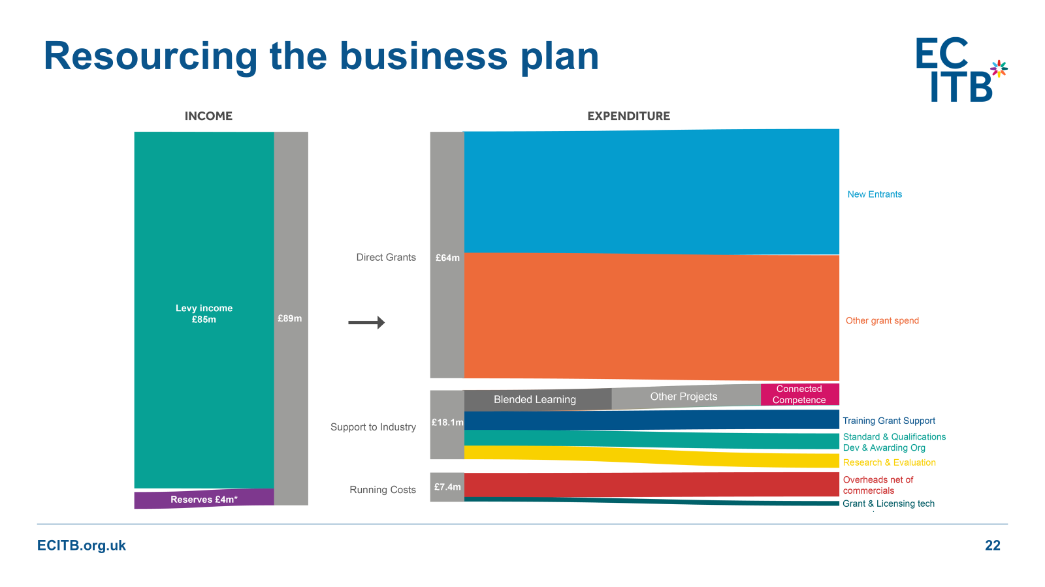
What did we plan to do during the strategy period?
What did we plan to do during the 23-25 strategy period?

Slide 14

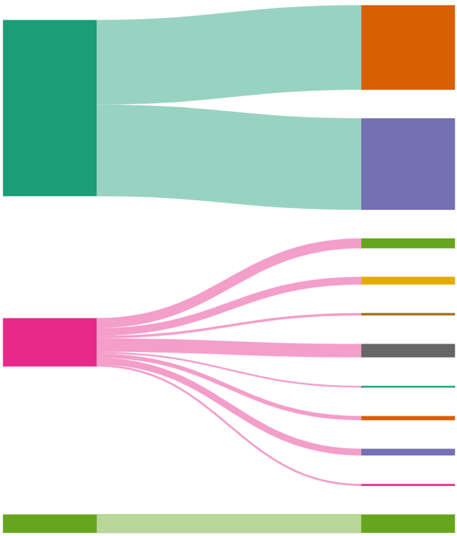
How has the plan changed?
New Entrants
Direct Grant
£70.6m
Other Grant Spend
Levy Income £92.9m
Standards & Quals
Support to Industry
£97.5m
Research & Evaluation
Provider Support
£19.4m
Training Grant Support
Grant & Exam Mgmnt system
Running Costs
£7.4m
Online Learning
Careers
Reserves £4.6m
Notes:
Levy primarily reinvested into grants, in addition to the creation of an attraction and training provider support budget

Slide 15
Reserves 2024-26

Slide 16
Grant vs Charitable Spend

Slide 17
Priorities for 2024
Foundations
Growing a Skilled Workforce
Supporting Industry in Transition
FOUNDATIONS
Workforce census
Implement ED&I action plan
Act on Customer Satisfaction review findings and deliver 2024 survey
Deliver the Infrastructure Renewal Project (upgrade and enhance ECITB grant and provider management software).
Embed project governance reforms (GIAA recommendations + Equality Impact Assessment)
Continue to roll out ECITB-led new entrant programmes in key trades/disciplines
Continue to support apprenticeships and graduates ensuring VfM for employers
Develop new careers materials and deliver STEM Returners pilot
Embed Connected Competence in oil and gas and roll out to other sectors
Scope out options to address tutor/trainer/assessor shortages
Roll out regional skills hub model (Humber investment announced Jan 2024 + capacity building projects in other regions)
Strategic skills planning for major projects, including Sizewell C and industrial clusters
Continue to fund and support NZ-related training
Grow commercial contribution at a rate that outpaces inflation

Slide 18
Labour Forecasting Tool
Jenny Young, Deputy Director, Strategy and Policy

Slide 19
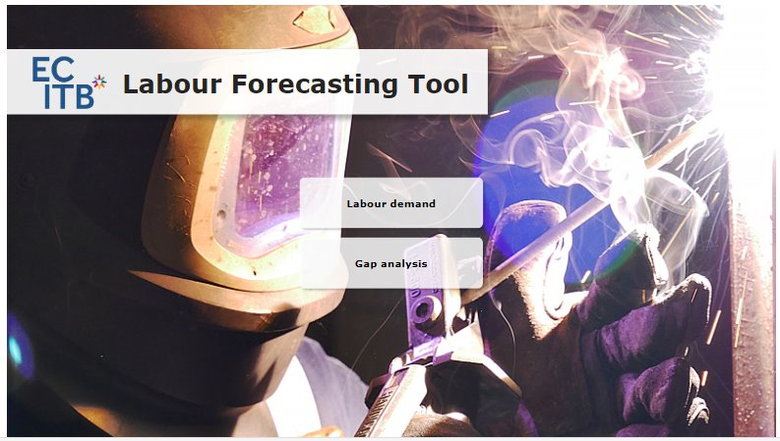
Background
Labour Forecasting Tool (LFT) was developed and launched in 2023
Responds to issue that engineering construction cannot easily be isolated in national ONS datasets
Data is drawn from ECITB and industry sources
      ECITB workforce census (2021)
      Infrastructure project data (public)
      Industry-shared demand information

Slide 20
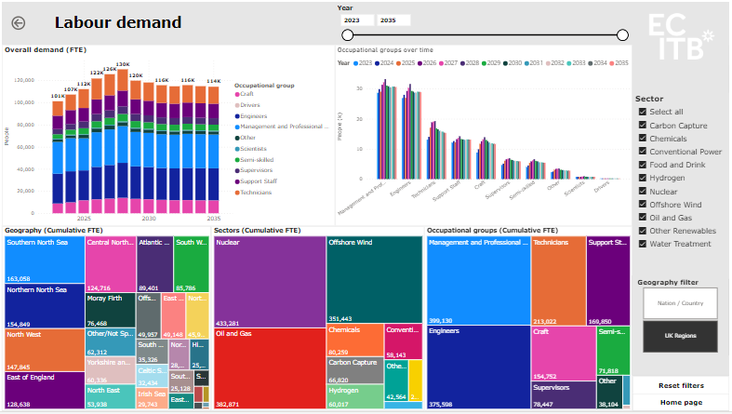
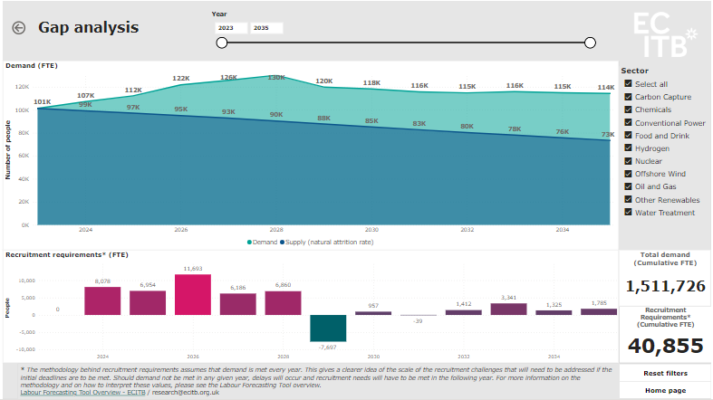
Tool visuals

Slide 21
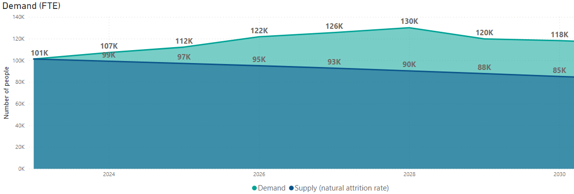

Widening skills gap
Demand could peak 2028
28% increase 2023 to 2028
Offshore wind & nuclear major drivers, demand for each could outstrip demand for O&G by 2030
Demand for H2 & CCS nearly 10% of ECI workforce before 2030
2030: Occupations in high demand…
Mechanical & electrical engineers
Scaffolders
Process engineers
Project managers & engineers
Pipefitters and welders
Instrument & control
Mechanical & electrical maintenance & fitters

Slide 22

Labour Forecasting Tool – Next steps
The level of accuracy of the model outputs is affected by:
The accuracy of the underlying supply data.
The level of completeness of the pipeline of projects fed into the model.
Our future plans:
Improve the quality of the underlying data - 2024 Workforce Census is key input.
Release more detailed data.
Collect feedback.
Support stakeholders in using the data
ECITB.org.uk

Slide 23
Career Motivations research
Inspiring Directions published today

Slide 24
Background
Inspiring directions: Understanding career choices to accelerate change
Objective:
To explore what motivates choices towards, or away from, engineering construction careers.
The report details:
The main factors influencing career choices, including the relative importance of the energy transition.
Analysis of gender differences in perceptions of the industry and associated career choices.
Differences in the public's and the ECI workforce's perception of individual sectors.
Sample:
154 ECI learners and workers, follow-up discussions to gather qualitative data
1,626 people representative of the UK population.

Slide 25
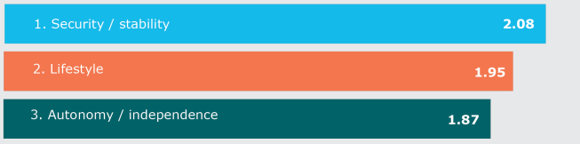
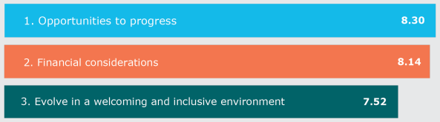
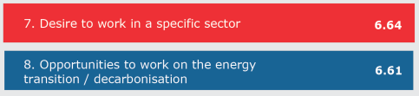
Careers Anchors and Motivating Factors
Top career anchors
Top factors influencing career choices…
… and the less important ones

Slide 26






Industry Perception
Most attractive sectors according to…
ECI workers and learners The wider public

Slide 27
Recommendations
Security and Stability
    Financial factors should not be underestimated
    Transferable competence recognition could help retention
Progression
    Individuals value opportunities to develop
    Importance of career plans
Lifestyle
    Flexible in-work policies for employees and recruitment
    Growing importance being placed on diversity and inclusion policies
Energy transition
    Explain ECI role in accessible, practical terms
    Especially important for public appeal
Insights should inform industry recruitment and retention activity.
They are being taken forward in our careers engagement planning to support industry attraction.

Slide 28
Customer Satisfaction Survey
2023 results summary
David Nash, Director of Strategy and Policy

Slide 29
Background to the 2023 CSS
      ECITB Customer and Stakeholder Research 2023
      Background
      Fieldwork and analysis produced by IFF Research Ltd
      Provides independently sourced feedback on ECITB performance and where we need to improve
      Survey covered feedback on strategic objectives as well as operational delivery
      Context of responses important:
      Increasingly tight labour market, inflation and cost-of-living pressures
      Many in-scope employers were on grant stop at time of survey due to tightened ECITB budgets
      Changes in working patterns post-Covid affected survey engagement by phone (37% response overall)

Slide 30
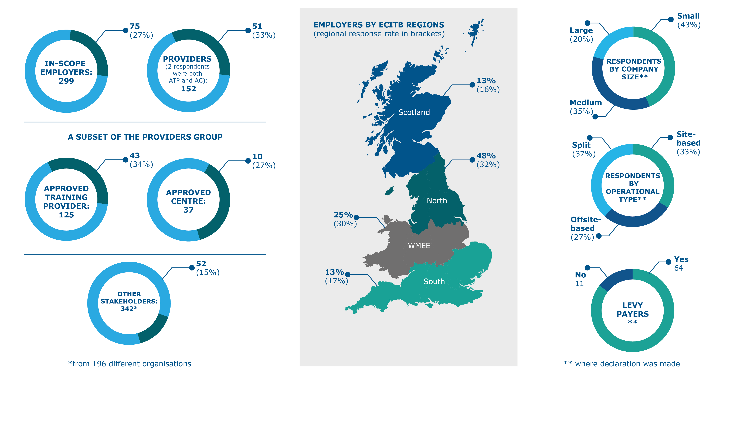
Respondent profiles

Slide 31
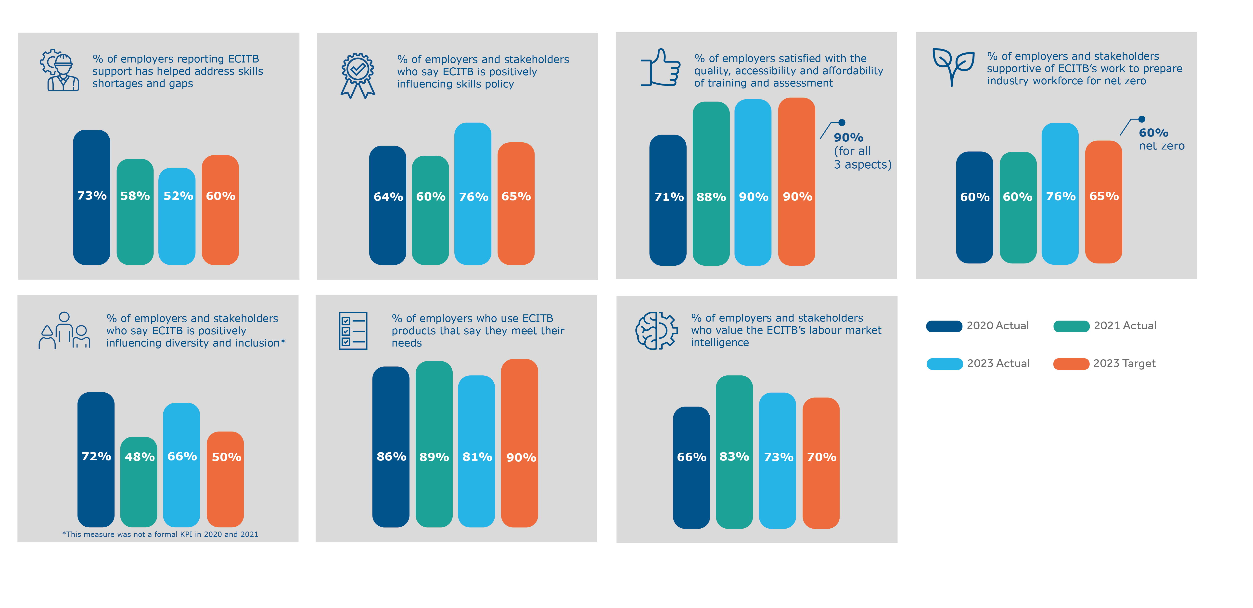
CSS Key performance indicators

Slide 32
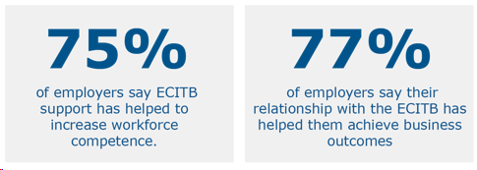
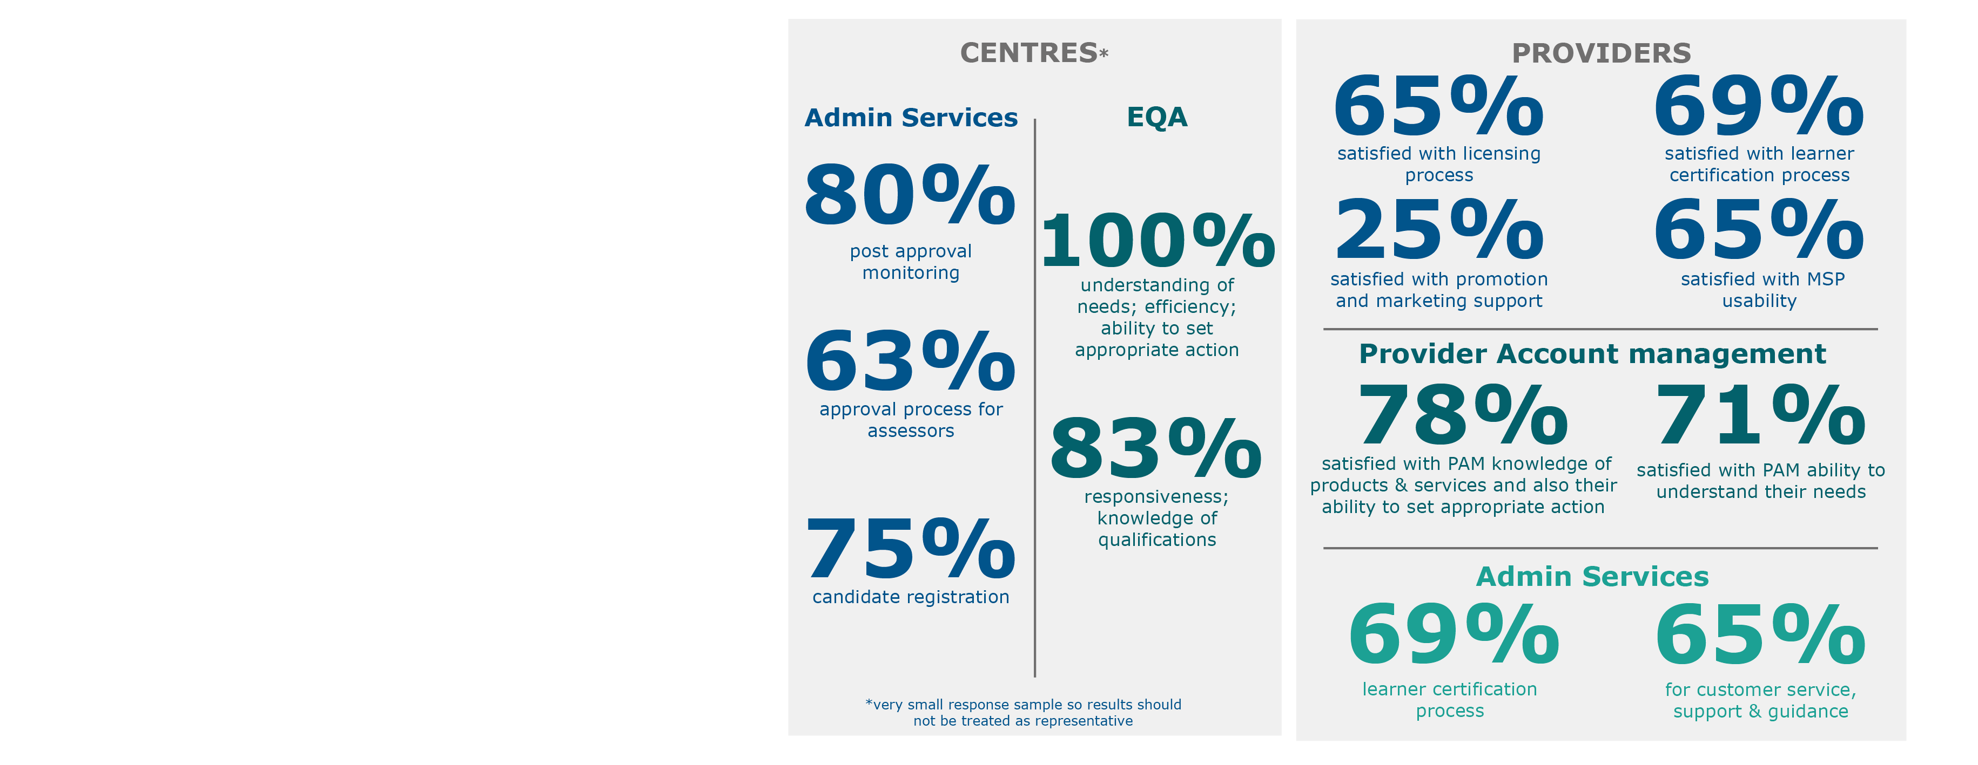
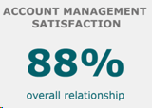
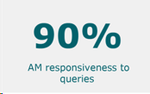
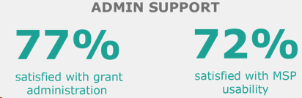
Satisfaction levels
Employers
Providers / Approved centres

Slide 33
ECITB’s Strategic added value
 | Employer view | Stakeholder view
Supporting training and recruitment of new entrants into the industry | 89% | 85%
Ensuring smaller companies can access training who may otherwise struggle to do so | 88% | 67%
Ensuring NOS, training standards and qualifications reflect industry requirements | 87% | 77%
Helping to address development and retention for priority skills shortages and provide training solutions for skills gaps | 84% | 85%
Improving access to quality and cost-effective training, including through blended and digital methods | 83% | 65%
By operating collective, redistributive levy ensuring training takes place that may not otherwise happen | 83% | 79%
Contributing positively to government policy on skills | 77% | 75%
Providing strategic leadership on skills for the industry | 76% | 88%

Slide 34
Areas for improvement
Area for improvement | Planned action in 2024
Addressing skills shortages and gaps | Use direct employer engagement, regional skills surveys and 2024 workforce census to target action Continue to develop new pathways into industry and produce online careers material Comms: ensure engagement is targeted effectively with appropriate support highlighted
Employer awareness of ECITB products | Refresh product catalogue to drive awareness of product offering Develop product strategy to guide prioritisation of internal resource/budget
Training provider support | Increase provider engagement and support (including through our Regional Skills Hub plans) Provider Approvals Manager recruited to speed up approvals and streamline communications Review marketing approach for different products (in line with new product strategy)
Satisfaction with response to Head Office queries | Provide better signposting on website for best contacts/routes for different queries Monitor and track our customer response times
Further demonstrate the value of policy / LMI activity | Establish Policy & Research Reference Group to increase awareness and engagement with stakeholder groups Increase capacity of team to support internal and external opportunities that deliver value-add
Survey response rate | Manage overall level of requests made to employers during year Explore greater use of online format and respondent targeting

Slide 35
Summary and Close
Andrew Hockey, Chief Executive Officer

Slide 36

Thank you

